Slide 1

MINI THERMO PROJECT (group 20)
Problem statement
Using the Soave-Redlich-Kwong (SRK) equation, find the molar volume of saturated-vapor and saturated-liquid propane at 400 K. Given P = 8.234 bar. Use the SRK constants from standard references and implement the iterative method in MATLAB to solve the problem.

Slide 2

(DATA INITIALIZATION)
% Given data
R=0.08314;
T = 400; % Temperature in Kelvin
P = 8.234; % Pressure in bar
% SRK constants for propane
a = 9.385; % Atm·L^2/mol^2
b = 0.09044; % L/mol
alpha = 0.944; % dimensionless
% Initial guesses for molar volume of vapor and liquid
V_vapor = 1 * R * T / P; % Initial guess for molar volume of vapor
V_liquid = 0.5 * R * T / P; % Initial guess for molar volume of liquid
% Tolerance for convergence
tolerance = 1e-6;
% Maximum number of iterations
maxIterations = 100;
% SRK equation and its derivative with respect to molar volume
SRK = @(V) P - R * T / (V - b) + a * alpha / (V * (V + b));
dSRK_dV = @(V) R * T / (V - b)^2 - a * alpha / (V + b)^2 - 2 * a * alpha / (V * (V + b)^2);
Tc = 369.8 K
Pc = 42.49 bar
a = 27 (R.Tc)^2 / 64.Pc
b = R.Tc / 8.Pc
Tr = T / Tc
Accentric Factor (w) = 0.152

Slide 3
Calculating Molar Volume Of Saturated Vapour
% Newton-Raphson iteration
for iteration = 1:maxIterations
% Calculate the function value and its derivative at the current guess
f = SRK(V_vapor);
df_dV = dSRK_dV(V_vapor);
% Update the guess for the molar volume using Newton- Raphson formula
V_vapor = V_vapor - f / df_dV;
fprintf('Molar volume of saturated-vapor propane at 400 K after %d iteration: %.4f L/mol\n', iteration, V_vapor);
% Check for convergence
if abs(f) < tolerance
break;
end
end
% Display results
fprintf('Molar volume of saturated-vapor propane at 400 K after %d iterations: %.4f L/mol\n', iteration, V_vapor);
OUTPUT
Molar volume of saturated-vapor propane at 400 K
after 1 iteration: 3.7863 L/mol after 2 iteration: 3.8910 L/mol after 3 iteration: 3.8528 L/mol after 4 iteration: 3.8676 L/mol after 5 iteration: 3.8620 L/mol after 6 iteration: 3.8641 L/mol after 7 iteration: 3.8633 L/mol after 8 iteration: 3.8636 L/mol after 9 iteration: 3.8635 L/mol after 10 iteration: 3.8636 L/mol after 11 iteration: 3.8635 L/mol after 12 iteration: 3.8636 L/mol after 13 iteration: 3.8636 L/mol after14 iteration: 3.8636 L/mol after 15 iteration: 3.8636 L/mol
RESULT = 3.8636L/mol

Slide 4
Calculating Molar Volume Of Saturated Liquid
OUTPUT
% Repeat the process for saturated-liquid propane
for iteration = 1:maxIterations
% Calculate the function value and its derivative at the current guess
f = SRK(V_liquid);
df_dV = dSRK_dV(V_liquid);
% Update the guess for the molar volume using Newton-Raphson formula
V_liquid = V_liquid - f / df_dV;
fprintf('Molar volume of saturated-Liquid propane at 400 K after %d iteration: %.4f L/mol\n', iteration, V_liquid);
% Check for convergence
if abs(f) < tolerance
break;
end
end
% Display results
fprintf('Molar volume of saturated-liquid propane at 400 K after %d iteration: %.4f L/mol\n',iteration, V_liquid)
Molar volume of saturated-vapor propane at 400 K
after 1 iteration: 3.4114 L/mol after 2 iteration: 3.9669 L/mol after 3 iteration: 3.8205 L/mol after 4 iteration: 3.8793 L/mol after 5 iteration: 3.8574 L/mol after 6 iteration: 3.8659 L/mol after 7 iteration: 3.8627 L/mol after 8 iteration: 3.8639 L/mol after 9 iteration: 3.8634 L/mol after 10 iteration: 3.8636 L/mol after 11 iteration: 3.8635 L/mol after 12 iteration: 3.8636 L/mol after 13 iteration: 3.8636 L/mol after 14 iteration: 3.8636 L/mol after 15 iteration: 3.8636 L/mol after 16 iteration: 3.8636 L/mol
RESULT = 3.8636L/mol

Slide 5
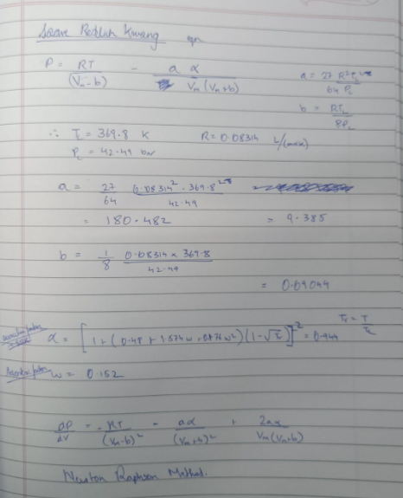
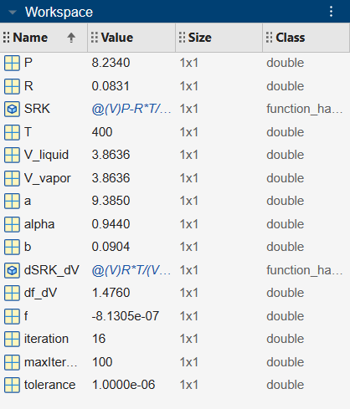
Workspace

Slide 6
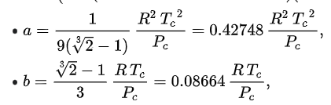
According to this the b value changes to 0.06269
Therefore output changes
Molar volume of saturated-vapor propane at 400 K after 1 iteration: 3.7311 L/mol Molar volume of saturated-vapor propane at 400 K after 2 iteration: 3.8659 L/mol Molar volume of saturated-vapor propane at 400 K after 3 iteration: 3.8147 L/mol Molar volume of saturated-vapor propane at 400 K after 4 iteration: 3.8356 L/mol Molar volume of saturated-vapor propane at 400 K after 5 iteration: 3.8273 L/mol Molar volume of saturated-vapor propane at 400 K after 6 iteration: 3.8306 L/mol Molar volume of saturated-vapor propane at 400 K after 7 iteration: 3.8293 L/mol Molar volume of saturated-vapor propane at 400 K after 8 iteration: 3.8298 L/mol Molar volume of saturated-vapor propane at 400 K after 9 iteration: 3.8296 L/mol Molar volume of saturated-vapor propane at 400 K after 10 iteration: 3.8297 L/mol Molar volume of saturated-vapor propane at 400 K after 11 iteration: 3.8296 L/mol Molar volume of saturated-vapor propane at 400 K after 12 iteration: 3.8297 L/mol Molar volume of saturated-vapor propane at 400 K after 13 iteration: 3.8296 L/mol Molar volume of saturated-vapor propane at 400 K after 14 iteration: 3.8296 L/mol Molar volume of saturated-vapor propane at 400 K after 15 iteration: 3.8296 L/mol Molar volume of saturated-vapor propane at 400 K after 16 iteration: 3.8296 L/mol Molar volume of saturated-vapor propane at 400 K after 16 iterations: 3.8296 L/mol
Molar volume of saturated-Liquid propane at 400 K after 1 iteration: 3.4604 L/mol Molar volume of saturated-Liquid propane at 400 K after 2 iteration: 3.9318 L/mol Molar volume of saturated-Liquid propane at 400 K after 3 iteration: 3.7852 L/mol Molar volume of saturated-Liquid propane at 400 K after 4 iteration: 3.8468 L/mol Molar volume of saturated-Liquid propane at 400 K after 5 iteration: 3.8227 L/mol Molar volume of saturated-Liquid propane at 400 K after 6 iteration: 3.8324 L/mol Molar volume of saturated-Liquid propane at 400 K after 7 iteration: 3.8285 L/mol Molar volume of saturated-Liquid propane at 400 K after 8 iteration: 3.8301 L/mol Molar volume of saturated-Liquid propane at 400 K after 9 iteration: 3.8295 L/mol Molar volume of saturated-Liquid propane at 400 K after 10 iteration: 3.8297 L/mol Molar volume of saturated-Liquid propane at 400 K after 11 iteration: 3.8296 L/mol Molar volume of saturated-Liquid propane at 400 K after 12 iteration: 3.8297 L/mol Molar volume of saturated-Liquid propane at 400 K after 13 iteration: 3.8296 L/mol Molar volume of saturated-Liquid propane at 400 K after 14 iteration: 3.8297 L/mol Molar volume of saturated-Liquid propane at 400 K after 15 iteration: 3.8296 L/mol Molar volume of saturated-Liquid propane at 400 K after 16 iteration: 3.8296 L/mol Molar volume of saturated-Liquid propane at 400 K after 17 iteration: 3.8296 L/mol Molar volume of saturated-liquid propane at 400 K after 17 iteration: 3.8296 L/mol
RESULT = 3.8296 L/mol
RESULT = 3.8296 L/mol

